Slide 1
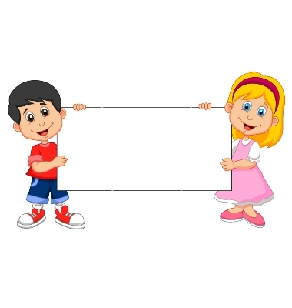
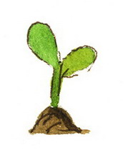
Donation
(Unable Plant)

Slide 2
Boys Version
Familiarization Task

Slide 3
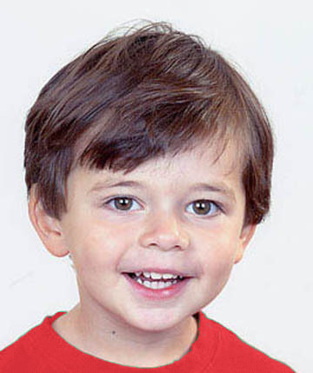
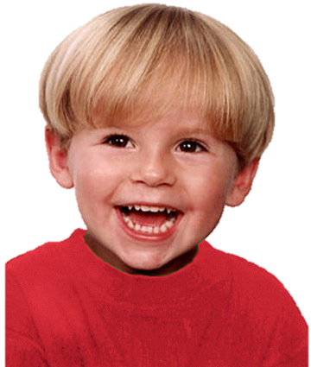
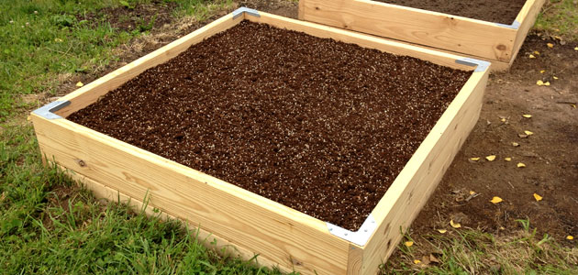
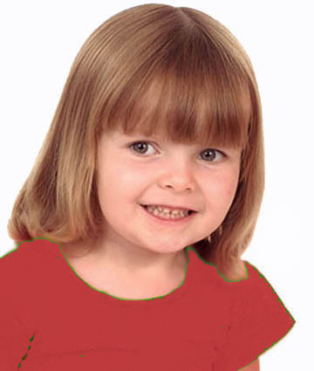
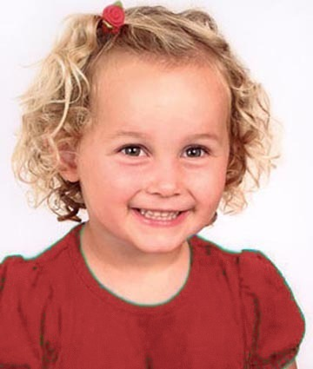
Introduce the group & the garden

Slide 4
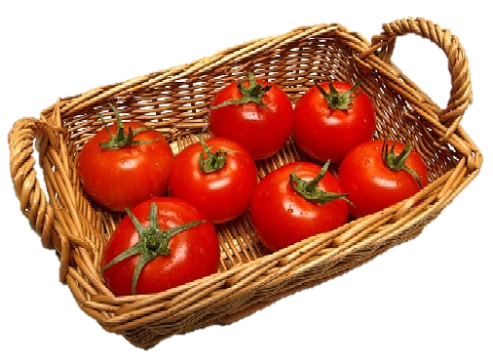
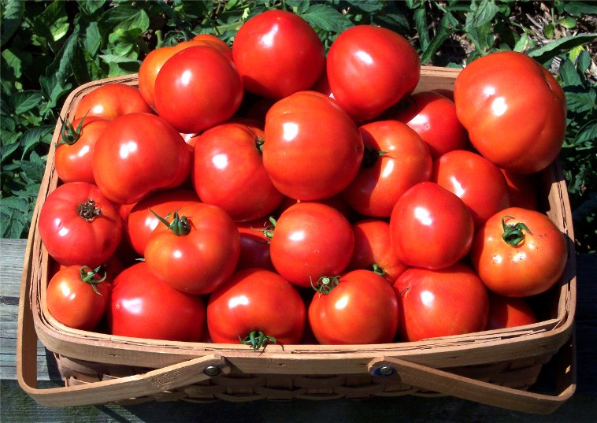
Explain how the garden works

Slide 5
Questions & Feedback

Slide 6
Test Task

Slide 7
The group goal: have a big basket of tomatoes and share them

Slide 8
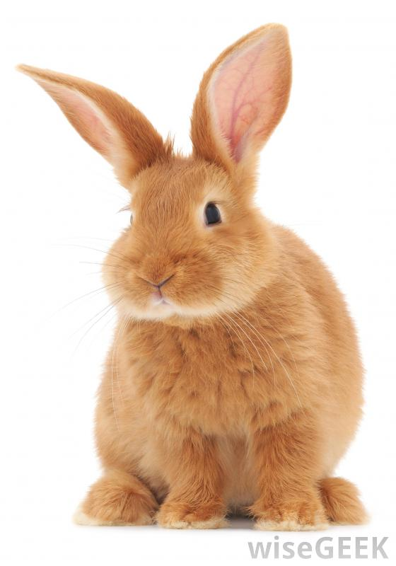
The boy (on the upper right corner) wants to put his plant in the group garden, but a rabbit comes to eat his plant. The other children put their plants into the garden.
Notes:
The boy (on the upper right corner) wants to put his plant in the group garden,
but a rabbit comes to eat his plant

Slide 9





Slide 10
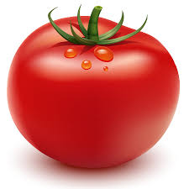
The outcome: They get a small basket of tomatoes. Each kid gets a tomato.

Slide 11
Test Questions
F
C

Slide 12
Unable Free-Rider Reminder:
Wanted to put his plant in the garden but a rabbit ate it.

Slide 13

Evaluation: is he good or bad?

Slide 14
Evaluation: a little good/bad or really good/bad?

Slide 15


Preference: Do you like him or you don’t like him?

Slide 16


Preference: do you like him a little or a lot? do you kind of don’t like him or really don’t like him?
To Contributor

Slide 17
Test Questions
Contributor

Slide 18
Contributor Reminder:
Wanted to put his plant in the garden and put it there.

Slide 19
Evaluation: is he good or bad?

Slide 20
Evaluation: a little good/bad or really good/bad?

Slide 21
Preference: Do you like him or you don’t like him?

Slide 22
Preference: do you like him a little or a lot? do you kind of don’t like him or really don’t like him?
To Free-Rider

Slide 23
Girls Version
Familiarization Task

Slide 24
Introduce the group & the garden

Slide 25
Explain how the garden works

Slide 26
Questions & Feedback

Slide 27
Test Task

Slide 28
The group goal: have a big basket of tomatoes and share them

Slide 29
The unable free-rider (upper right):
Wants to put her plant in the garden, but a rabbit comes to eat it

Slide 30
The outcome: They get a small basket of tomatoes. Each kid gets a tomato.

Slide 31
Test Questions
F
C

Slide 32
Unable Free-Rider Reminder:
Wanted to put her plant in the garden but a rabbit ate it.

Slide 33
Evaluation: is she good or bad?

Slide 34
Evaluation: a little good/bad or really good/bad?

Slide 35
Preference: Do you like her or you don’t like her?

Slide 36
Preference: do you like her a little or a lot? do you kind of don’t like her or really don’t like her?
To Contributor

Slide 37
Contributor Reminder:
Wanted to put her plant in the garden and put it there.

Slide 38
Evaluation: is she good or bad?

Slide 39
Evaluation: a little good/bad or really good/bad?

Slide 40
Preference: Do you like her or you don’t like her?

Slide 41
Preference: do you like her a little or a lot? do you kind of don’t like her or really don’t like her?
To Free-Rider

